Slide 1
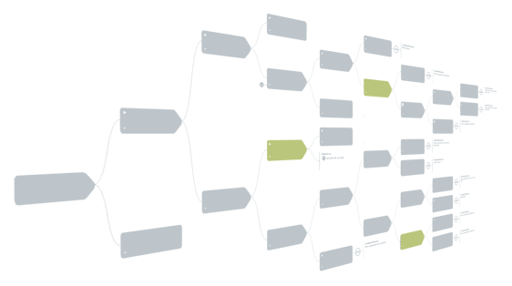

Causelink Enterprise RCA Software
Introduction
Notes:
1

Slide 2
Agenda
Roles and capabilities
RCA view permissions
Types and groups
RCA actions

Slide 3
Roles and Capabilities
 | Analyst | Manager | Admin | IT
Delete People accounts |  | x | x | x
Create and update People accounts | x | x | x | x
View all User and People accounts | x | x | x | x
Create, edit, delete Analyst accounts |  | x | x | x
Create, edit, delete Manager accounts |  |  | x | x
Create, edit, delete Admin and IT accounts |  |  |  | x
Edit all RCAs |  |  | x | x
View all RCAs |  | x | x | x
Only view certain* RCAs | x
Only edit certain* RCAs | x | x
Create new RCAs | x | x | x | x
Delete RCAs |  |  | x | x
Run reports across all RCAs |  | x | x | x
Ignore common cause terms |  | x | x | x
Access to administration |  |  | x | x
Access to system settings (timeout, map, email, authentication) |  |  |  | x
* Permissions defined for each RCA record by group or specific user accounts

Slide 4
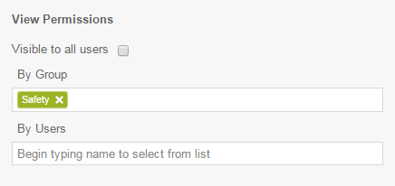
RCA View Permissions
Manager, Administrator, and IT roles can view all RCAs in the system
View permissions for users with the Analyst role are set on the RCA Overview page of each record
View permissions can be defined as visible to all users, visible to specific groups, and/or visible to specific users

Slide 5
Types and Groups
 | Types | Groups
Options controlled in Administration | x | x
RCAs tagged as one or more | x | x
Impacts search filters | x | x
Impacts report filters | x | x
Can be associated to users |  | x
Can control RCA view permissions |  | x

Slide 6
Actions
Three types of actions can be generated from an RCA record. All actions are tracked in the system and periodically emailed to assignees.
Workflow Actions – A user will be assigned to the currently open workflow step.
Solution-related Actions – Once a solution is approved, it is assigned to a user and tracked as an action.
Custom Actions – Enter custom actions and assign them to users on the RCA Report > Actions page.

Slide 7
Sologic Contacts and Information
Contact
Jon Boisoneau – Product Manager
More Information
Causelink Desktop Page (description, trial download, system requirements)
Causelink Desktop Video
Causelink Enterprise Page (description, system requirements, demo request form)
Causelink Enterprise Video

